Slide 1
C Programming
Chapter 6

Slide 2
Switch statement
The switch statement allows us to execute one code block among many alternatives.
You can do the same thing with the if...else..if ladder. However, the syntax of the switch statement is much easier to read and write.

Slide 3
switch
switch (expression)
{
case constant1: statement
. . .
statement
case constant_2: statement
. . .
statement
case constant_n: statement
. . .
statement
default : statement
. . .
statement
} /* end switch */

Slide 4
The break Statement
The break statement causes a jump out of a switch statement.
Execution continues after the closing brace of the switch statement.

Slide 5
Example Using the switch Statement
switch (val) {
case 1:
++a_cnt;
break;
case 2:
case 3:
++b_cnt;
break;
default:
++other_cnt;
}
The val expression must
be of an integer type.
The constant integral
expressions following the
case labels must all be
unique.

Slide 6
The Effect of a switch Statement
Evaluate the switch expression.
Go to the case label having a constant value that matches the value of the expression found in step 1.
If a match is not found, go to the default label.
If there is no default label, terminate the switch.
Terminate the switch when a break statement is encountered, or by “falling off the end”.

Slide 7
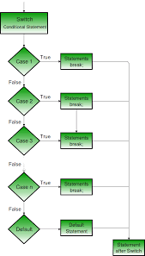

Slide 8
#include<stdio.h>
int main(){
int num1,num2,choice;
printf("\n Enter two numbers to compute: ");
scanf("%d%d",&num1,&num2);
printf("\n Select the operation to perform: \n1. Add \n2. Subtract \n3. Multiply \n4. Divide \nchoose: ");
scanf("%d",&choice);
switch(choice){
case 1: printf("\nSum = %d",num1+num2);
break;
case 2: printf("\nDifference = %d",num1-num2);
break;
case 3: printf("\nProduct = %d",num1*num2);
break;
case 4: printf("\nQuotient = %d",num1/num2);
break;
default:printf("\nwrong input");
}
return 0;
}

Slide 9
C goto statement
When a goto statement is encountered in a C program, the control jumps directly to the label mentioned in the goto stateemnt

Slide 10
The goto Statement
goto causes an unconditional jump to a labeled statement somewhere in the current function.
Form of a labeled statement.
label: statement
Where label is an identifier.

Slide 11
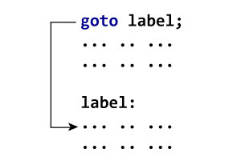
Syntax of goto
goto label;
... .. ...
... .. ...
label:
statement;

Slide 12
Example goto
printf("\nenter the value of x: ");
scanf("%f", &x);
if (x < 0.0)
goto negative_alert;
printf("%f %f %f",x,sqrt(x),sqrt(2 * x));
negative_alert:
if (x < 0.0)
printf("Negative value encountered!\n");

Slide 13
When Should goto Be Used?
Almost never (it is never needed).
gotos can make a program very difficult to read and understand.
In rare instances such as exiting from a deeply nested inner loop to the outermost level, a goto can make a program execute with significantly greater efficiency.

